Slide 1


CAPSTONE
Sleep Inducer
P-07
Group Member - Kavya Chauhan, Bhavya Boda, Prince Chovatiya, Tirth Gandhi

Slide 2


TABLE OF CONTENT
Agenda
01 | PROBLEM | 02 | ALGORITHM
03 | DATA STRUCTURES CHOSEN | 04 | TIME-COMPLEXITY
05 | SPACE-COMPLEXITY | 06 | FINAL CODE

Slide 3
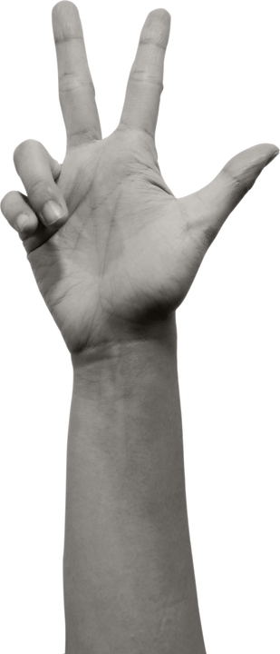




PROBLEM
You are to build a Sleep Inducer. There are N inmates in total. Each has his/her own sleep time (randomly initialized). The Sleep Inducer is installed in a hostel with M sleeping dorms. It notes every inmate’s daily sleeping habits and starts sleep-inducing music at bedtime. It works for multiple inmates. However, the music should not continue beyond p minutes after going to bed (assuming it takes that much time for every inmate to fall asleep). The Sleep Inducer should be able to play for all of them without disturbing anyone (i.e., playing music while someone is asleep). Therefore, the correct number of inmates for each dorm must be assigned before starting to operate.
Input data will be a file (can be txt or xls) with records in the format:
Inmate record
Inmate name
Earpod ID
Inmate sleep time (for each of 7 days)
Time taken by the inmate to fall asleep (i.e., p in minutes)
Dorm record
Dorm name
Set of music channels (IDs) assigned
Set of music per channel (IDs)
Assume inmates have earphones/pods to listen with. Each pod is connected to a specific channel where only one music can be played at any given time.
When one inmate falls asleep, his earpod deactivates, and the channel is assigned to another earpod (i.e., inmate in the same room), provided that the inmate is still awake.
Assume that the music system is centralized for a given room (with multiple dedicated channels that are assigned and released from time to time). Different music (and corresponding channels) can be played in different rooms.

Slide 4
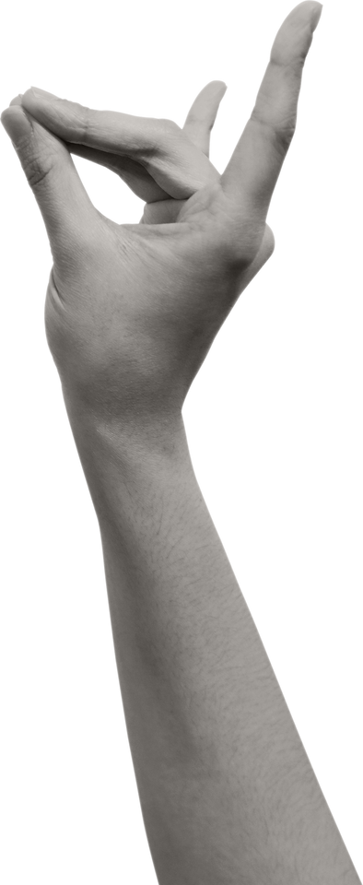
Algorithm
ALGORITHM
Algorithm(Sleep Inducer) Link (Hyperlink)

Slide 5
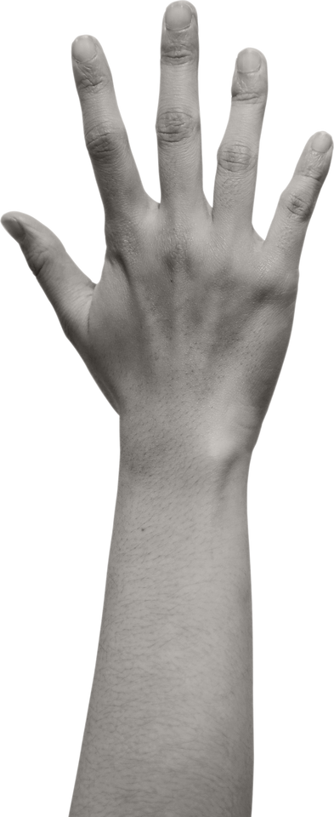
Chosen
DATA STRUCTURE
1. Vectors: Here, the vectors are used to store inmate details such as their names, their
earpod IDs, their sleeping times for each day, and p’s. These are more preferable than
arrays since we do not need to fix the size of it (Dynamic Resizing). This could be beneficial
in cases where the number of inmates and dorms may vary according to the user input.
Also, accessing and iterating through the individual elements can be done in an efficient way.
2. Stacks: Stacks are utilised to represent dorm allocations for each day. Each dorm has a
stack for each day, where inmates are pushed based on their allocation. They show LIFO
behaviour (Last In First Out). This means that the last allocated element can be accessed
first. This could be useful for the channel assignment part. It is a simple and straight-forward
data structure. It provides a way in which the inmates can be organised and manipulated
easily.
3. Classes: In the code, class is used to store information regarding inmates and dorms.
Classes encapsulate related attributes with methods into a single capsule. In this particular
code, the Inmate class encapsulates details such as inmate names, ids, sleep times and p
while the Dorm class encapsulates dorm names and the set of channels.

Slide 6

1. Sorting the vector a of size Number_Inmate takes O(n* log(n)) time.
2. Sorting the vector v of stacks takes O(n * log(n)) time.
3. Looping through the dorms and their channels takes O(numdorms) time.
4. Inside the dorm loop, iterating through the stacks in v takes O(n) time in the worst case.
(n is number of Inmates)
So, the overall time complexity of the code is O(n * log(n)) + O(n * log(n)) + O(numDorms * n), which simplifies to O(n * log(n)) assuming n > numDorms.
TIME-COMPLEXITY

Slide 7

1. Vector of Inmates (inmates): O(n) space.
2. Vector of dorms (dorms): O(numDorms) space.
3. Vector of channels (Channel): O(numDorms) space.
4. Vector a of pairs: O(n) space.
5. Vector v of stacks: The space complexity of this depends on the number of stacks created. In the worst case, it could be O(n) if each inmate forms its own stack.
6. Stacks within v: The space complexity of these stacks combined is O(n) in the worst case.
So, the overall space complexity of the code is O(n) + O(numDorms) + O(n) + O(n) + O(n) + O(n) = O(n) assuming Number_Inmate > numDorms. (n is number of Inmate)
SPACE-COMPLEXITY

Slide 8


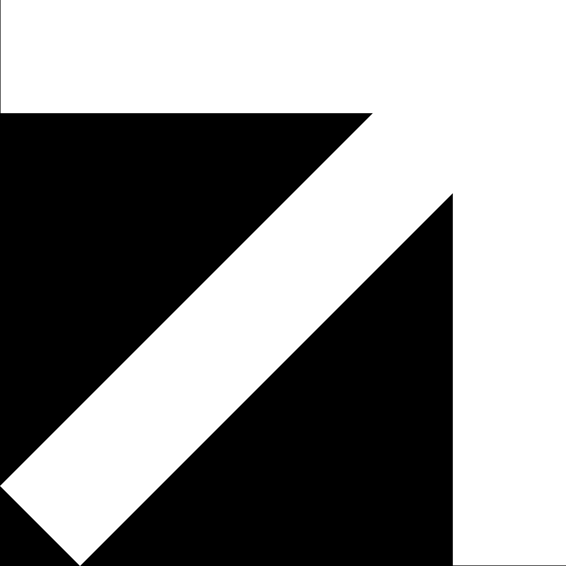
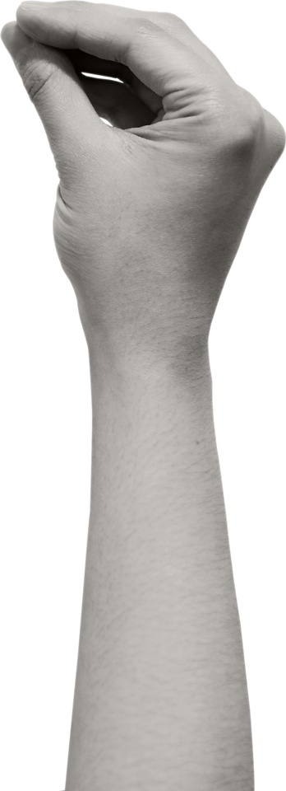
Running
Code
2023

Slide 9
Bonus
QUESTION
Given the provided scenario, how would you design and implement a Sleep Inducer system that efficiently assigns inmates to sleeping dorms while considering the following factors:
Special Requirements: Some inmates might prefer to stay in the same room in a group or pair.
Preferences: Inmates may have favorite music or preferences related to dorm location, which should be accommodated if possible.
Dorm Capacity: Each dorm has a capacity, and once full, other inmates need to be assigned to the next available dorm.
Gender-based Assignment: Ensuring that inmates assigned to the same dorm are of the same gender.
Dorm Transfer Restrictions: Inmates may have restrictions on transferring dorms multiple times, limiting the number of transfers per week.
Furthermore, the system should ensure that sleep-inducing music is played for each inmate without disturbing others, stopping the music p minutes after each inmate goes to bed. The system should also manage centralized music systems for each dorm, with multiple dedicated channels that can be assigned and released as needed, allowing different music to be played in different rooms.

Slide 10
THANK
You

